Slide 1

ChildWare Demo
Dr. Gail Farally-Semerad
ChildWare Program Manager
Early Childhood Education

Slide 2
Introduction
What is ChildWare?
ChildWare was launched in 2010 as part of the Pennsylvania Shared Services Initiative, a joint project with the Delaware Valley Association for the Education of Young Children (DVAEYC).
With support from the William Penn Foundation, PHMC worked with a pilot group of providers to develop a software-based technical assistance model to meet the increasingly complex data management, administrative, and reporting needs of local childcare providers.
Participation in the program grew exponentially with the addition of the PHLpreK program and today over 100+ individual ECE centers log into the system every day to track attendance, bill parents, record health assessments, and do all the many, many, tasks associated with managing a center.

Slide 3
Agenda
What are the benefits of using ChildWare for your business?
Review of ChildWare functionality:
  Data Management – children and staff
  Billing/Invoicing
  Attendance/Staff Kiosk
  Document Center
  Support and Resources
  Q & A

Slide 4
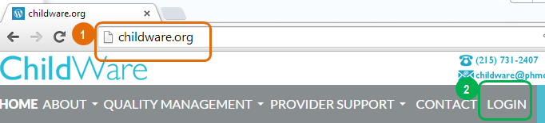
Logging into Childware
To log in to ChildWare, go to http://www.childware.org using your web browser.
We recommend Google Chrome or Mozilla Firefox.
Click “Login”.
Must use the CHROME Browser to access ChildWare

Slide 5
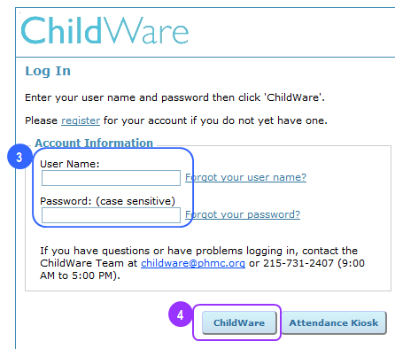
Login Screen
Enter your User Name and Password
Click “ChildWare” to enter the system.
Enter your User Name and Password
Click “ChildWare” to enter the system.

Slide 6
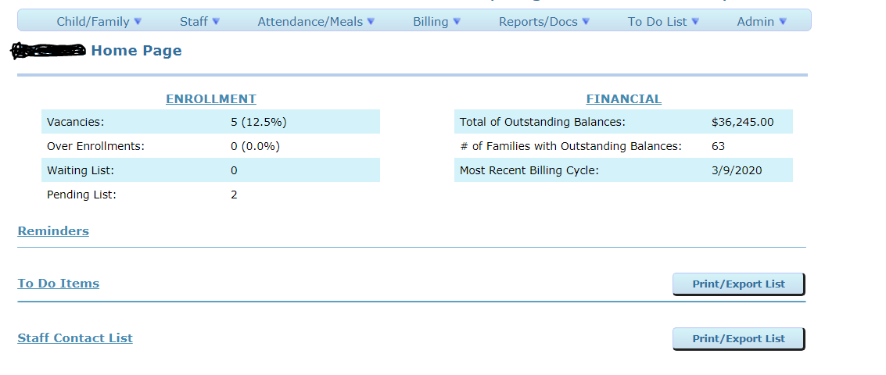
Home Page

Slide 7
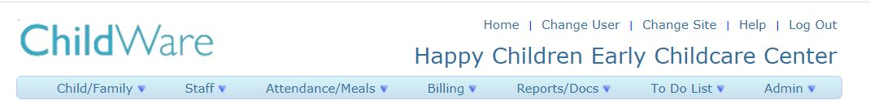
Action Bar
Child/Family – Child Date, Contact Data, Bulk Service Updates, Batch Record Updates, Notification Emails, Pin Maintenance
Staff – Staff Data, Bulk Training Entry, Bulk PD Event Entry, Pin Maintenance
Attendance/Meals – Regular Attendance, Drop In Attendance, Attendance Log
Billing – Family Billing, Batch Charges, Batch Payments/Credits, Subsidy Reconciliation
Reports/Docs – Reports, Blank Forms, Document Center, Data Export to Excel, Report Definitions
To Do List – To Do List, To Do List Setup, To Do List Definitions
Admin - Agency/Site, Doctors, System Log, System Users, System User Roles

Slide 8
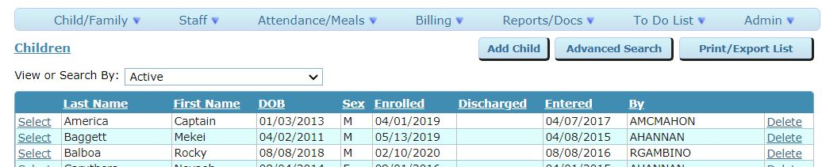
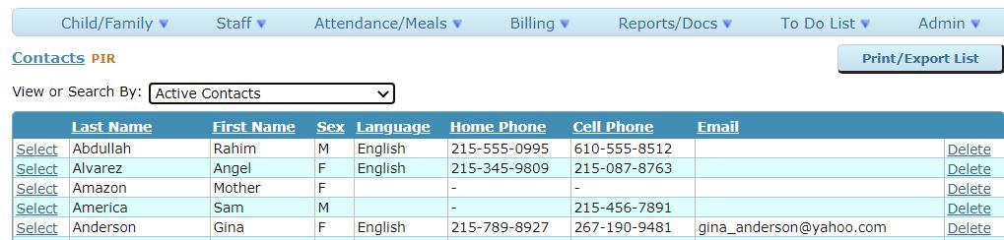
Child/Family
Child Data
Contact Data

Slide 9
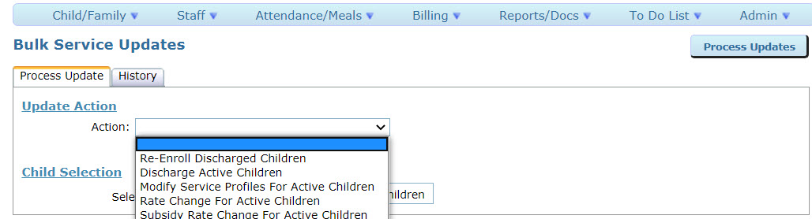
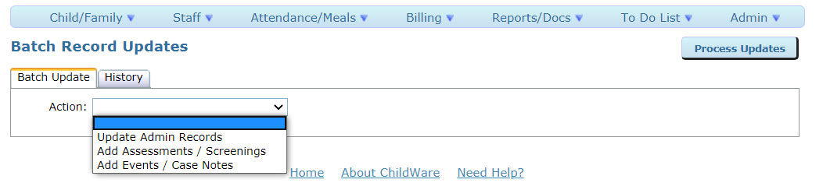
Child/Family
Bulk Service Upgrades
Batch Record Updates

Slide 10
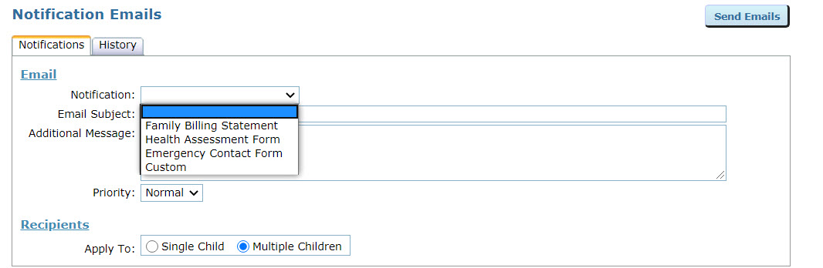
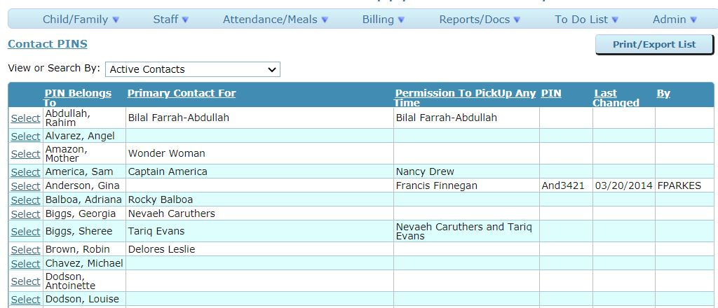
Child/Family
Notification Emails
PIN Maintenance

Slide 11
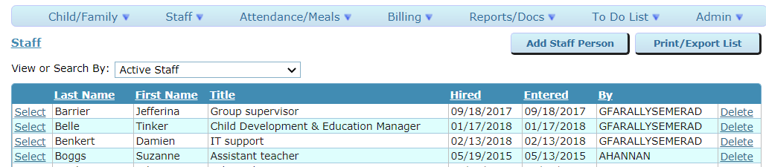
Staff
Staff Data

Slide 12
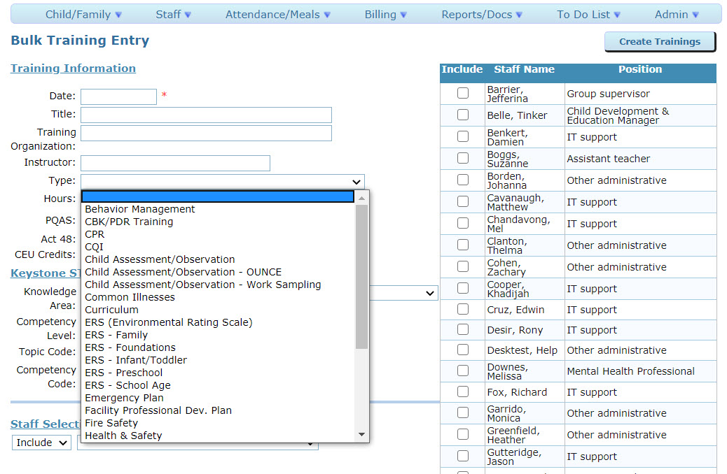
Staff
Bulk Training Entry

Slide 13
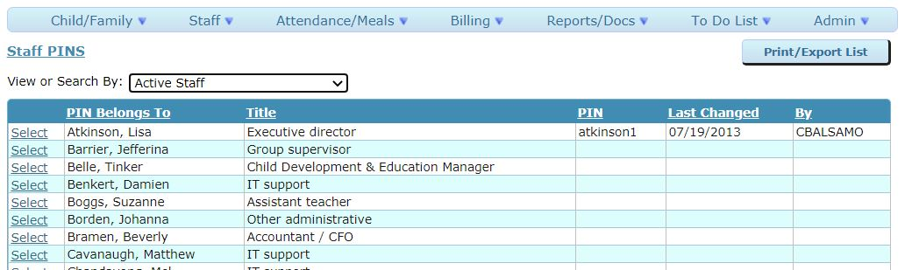
Staff
Staff Pin Maintenance

Slide 14
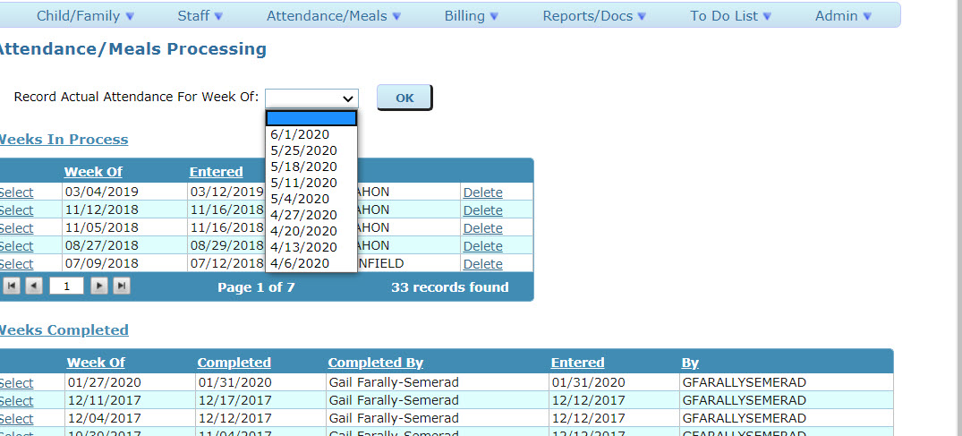
Attendance/Meals
Regular Attendance

Slide 15
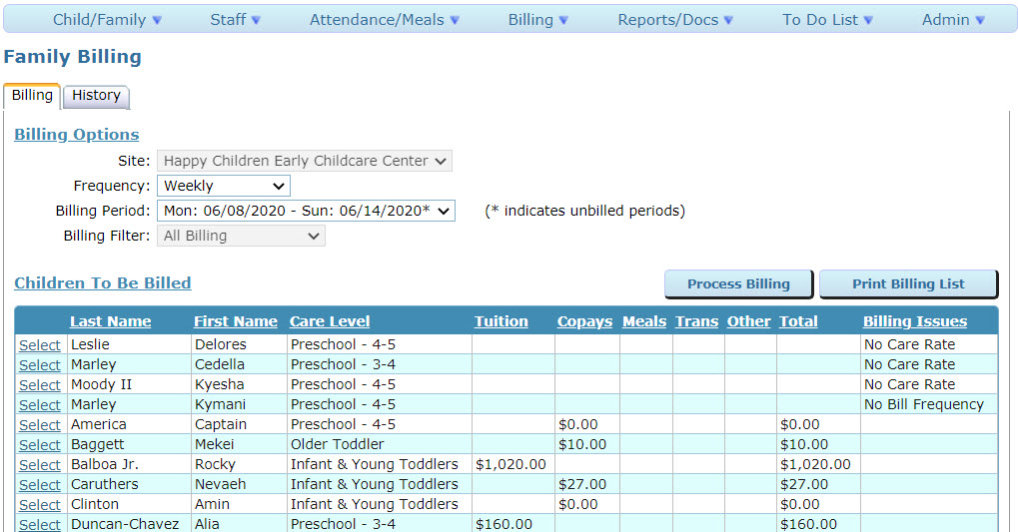
Billing
Family Billing

Slide 16
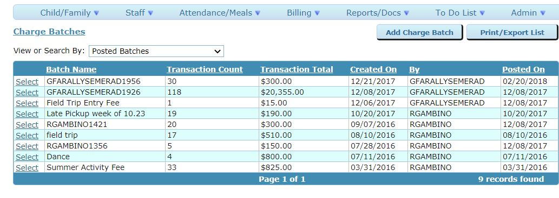
Billing
Batch Charges

Slide 17
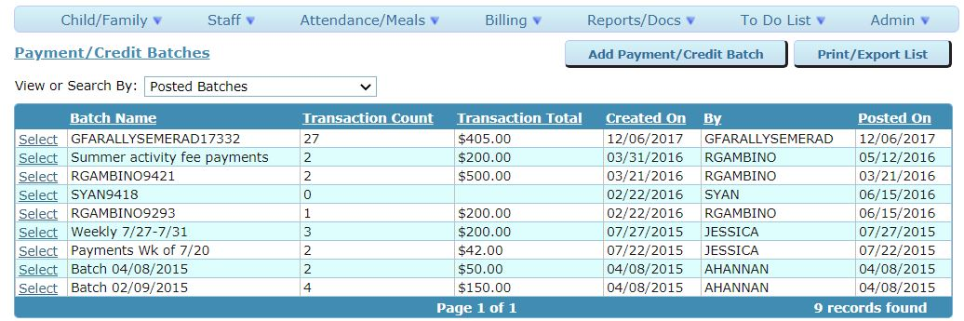
Billing
Payment/Credit Batches

Slide 18
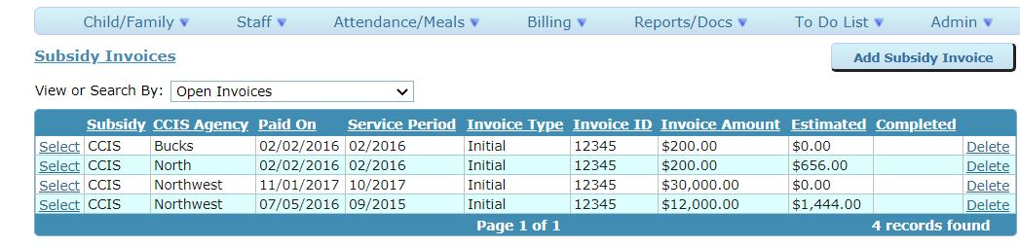
Billing
Subsidy Reconciliation

Slide 19
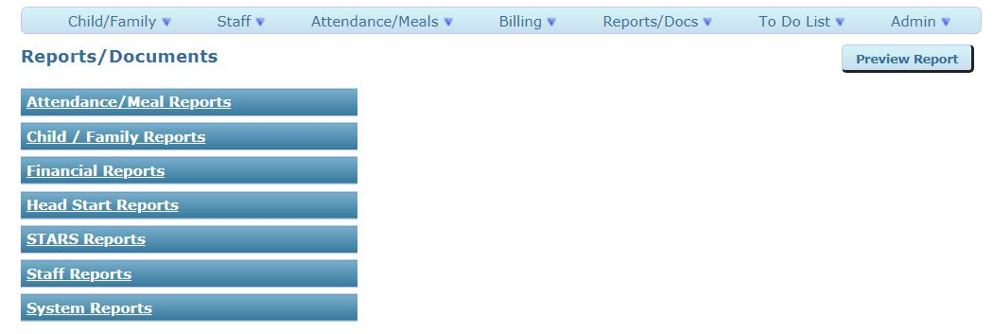
Reports/Docs
Reports

Slide 20
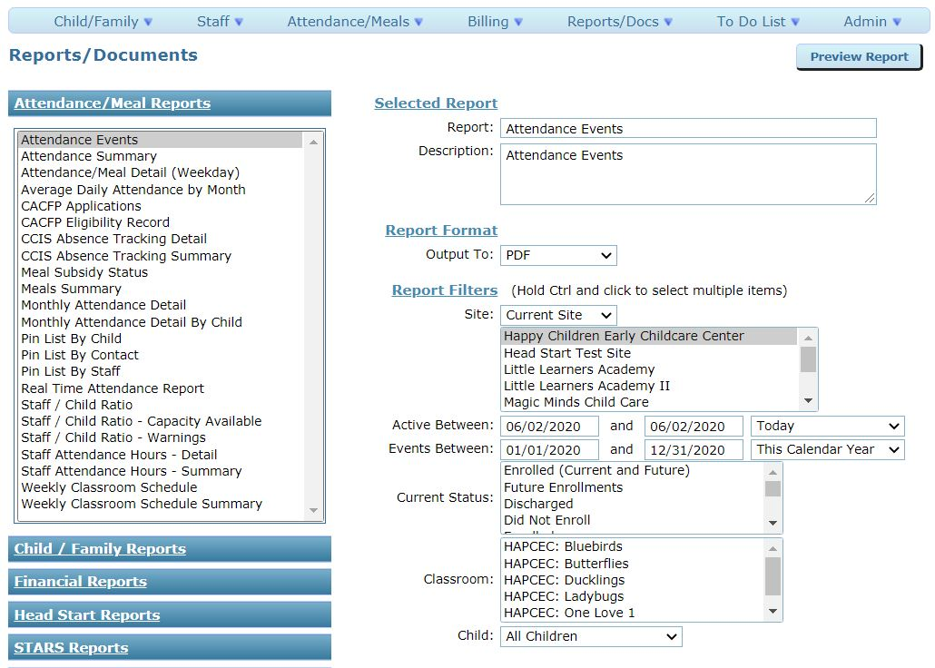
Attendance/Meal Reports

Slide 21
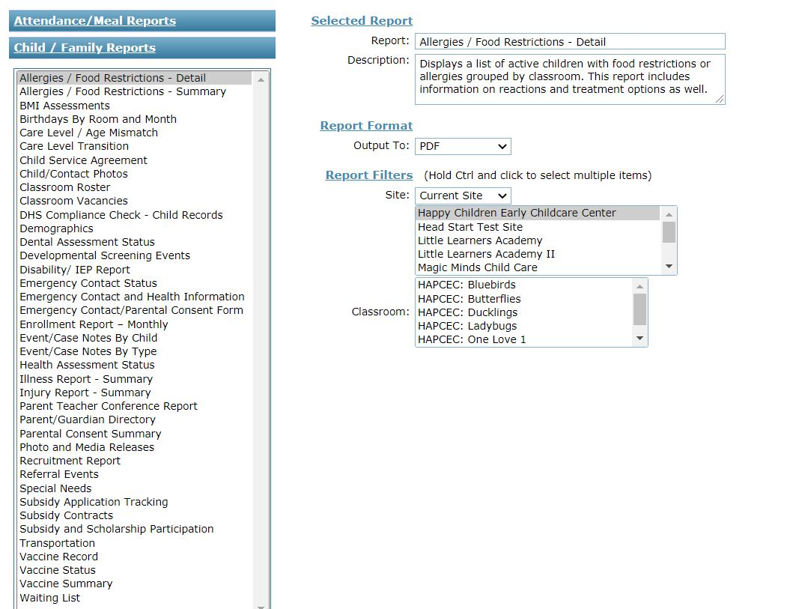
Child Family Reports

Slide 22
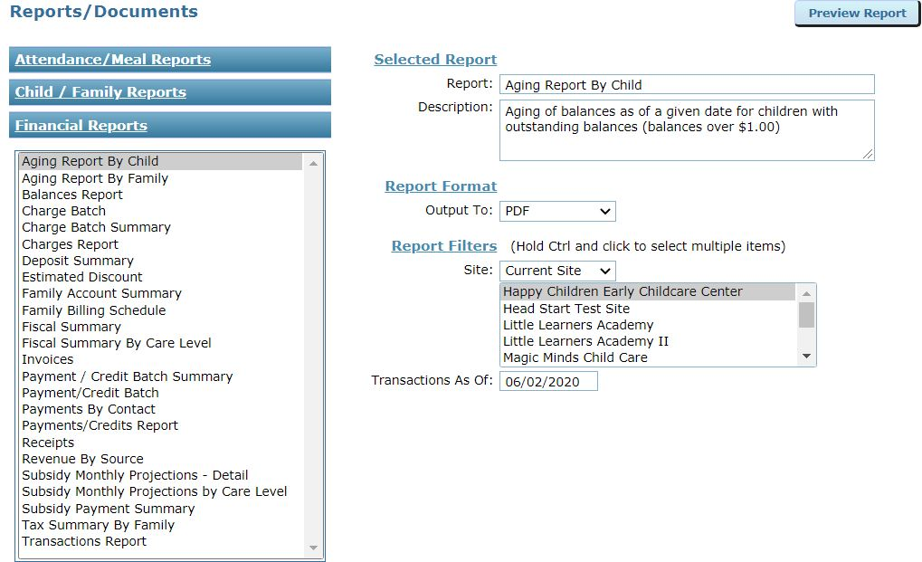
Financial Reports

Slide 23
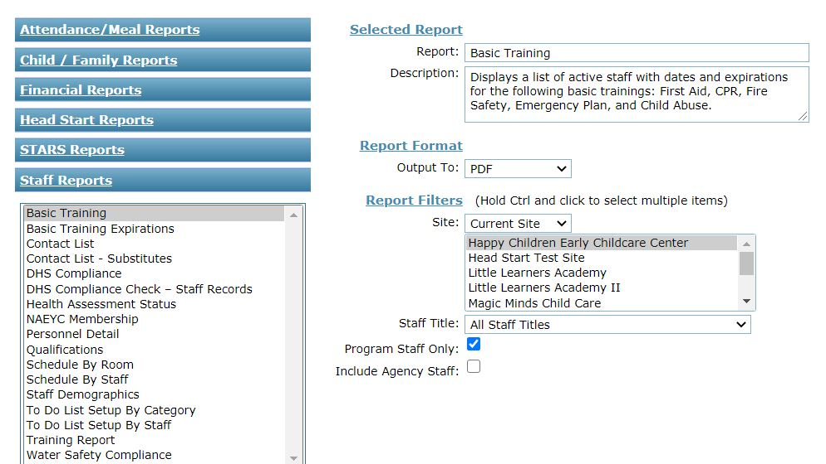
Staff Reports

Slide 24
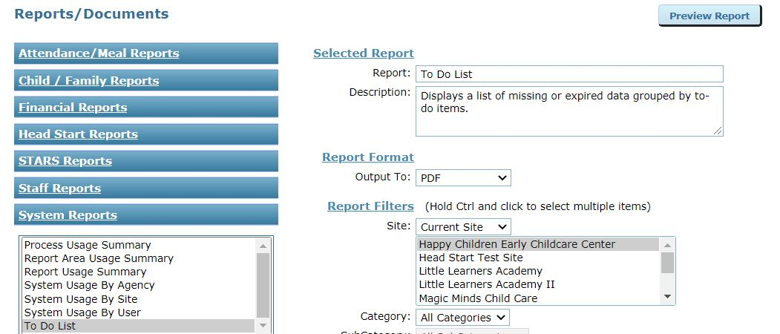
System Reports

Slide 25
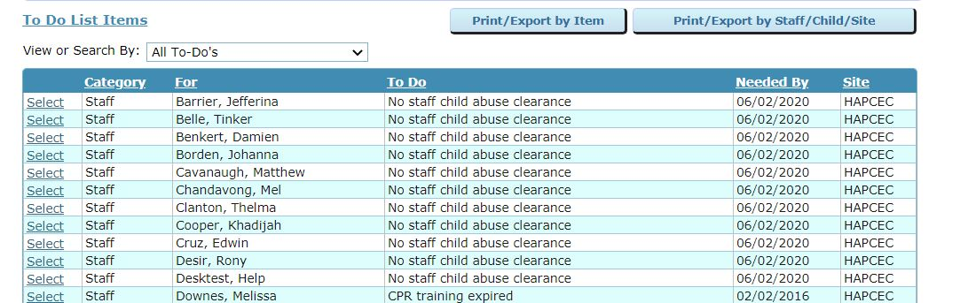
To Do List

Slide 26
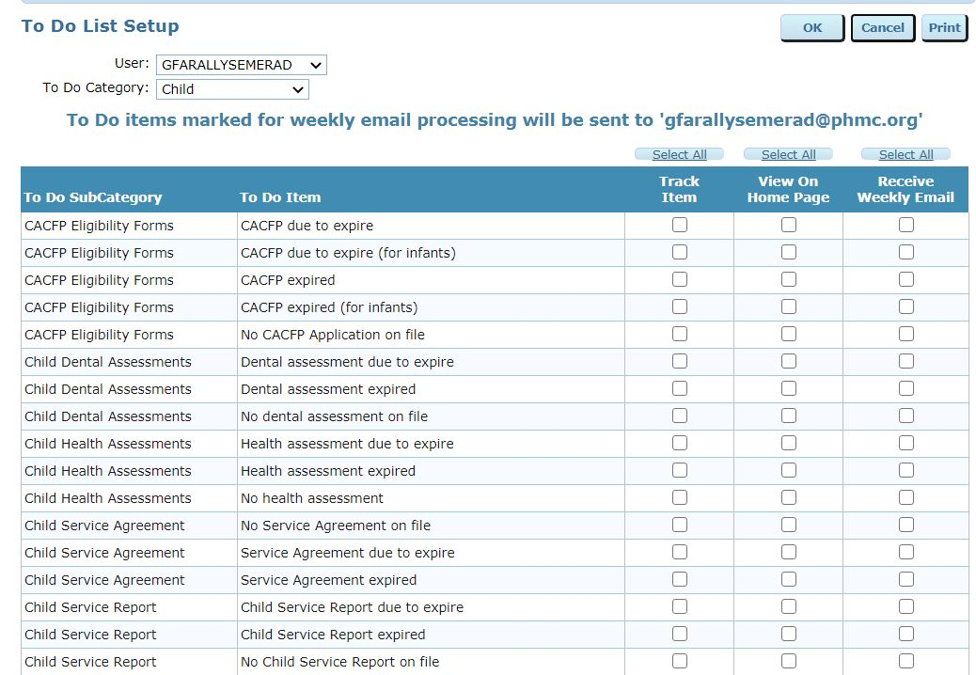
To Do List

Slide 27
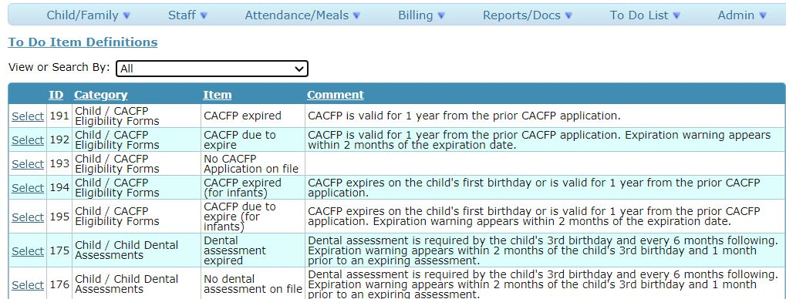
To Do Definitions
96 To Do Definitions

Slide 28
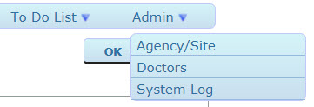
Admin

Slide 29
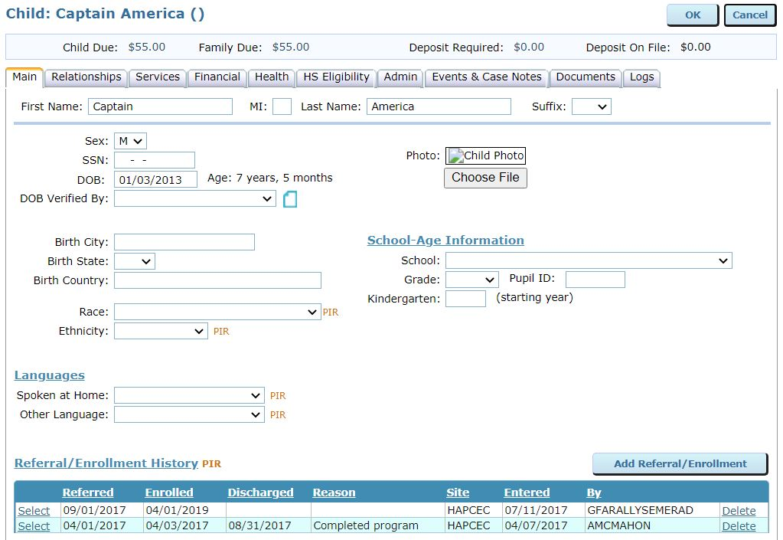
Child’s Record

Slide 30
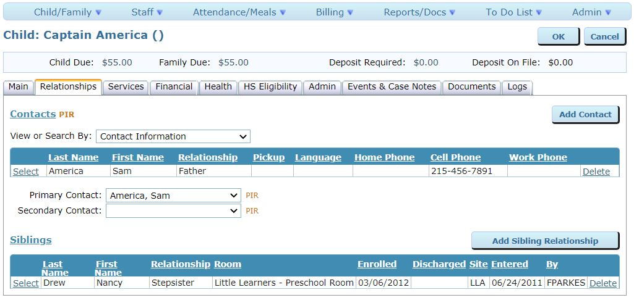
Child Relationship

Slide 31
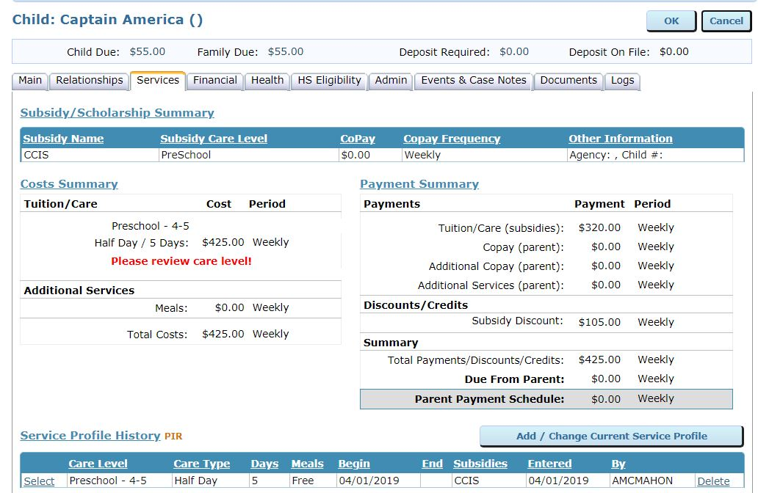
Child Services

Slide 32
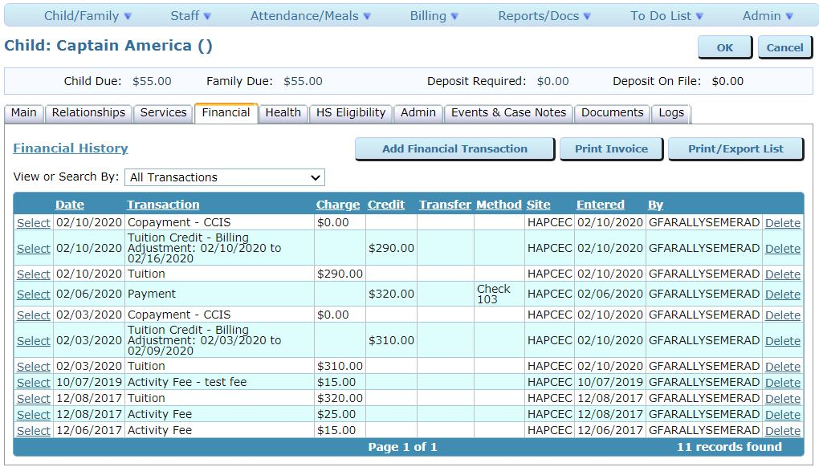
Child Financial

Slide 33
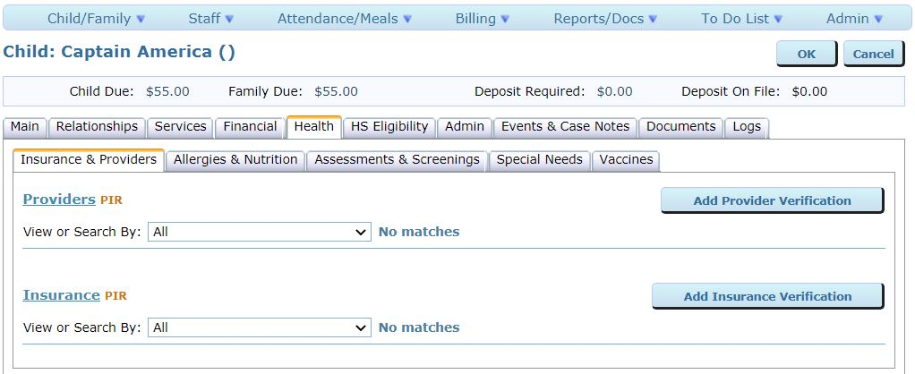
Child Health

Slide 34
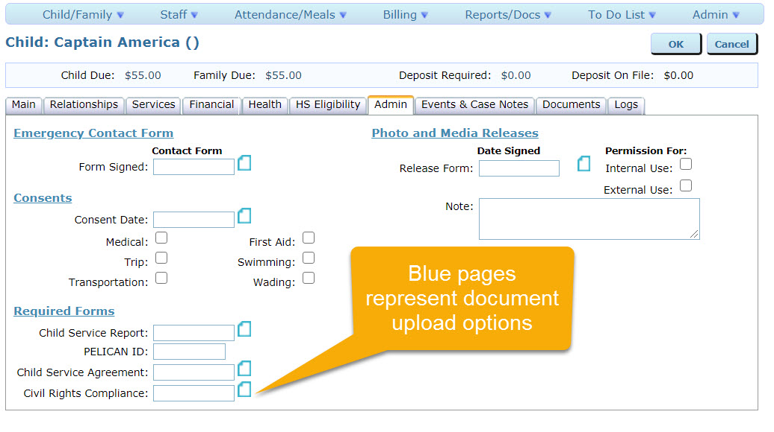
Child Admin

Slide 35
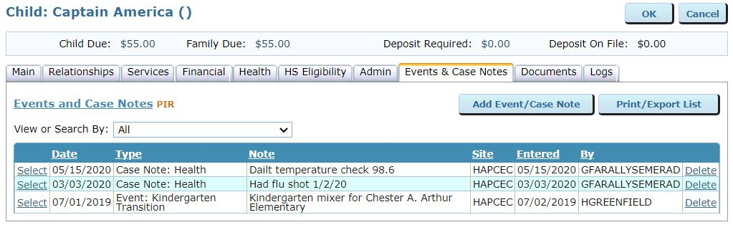
Child Events & Case Notes

Slide 36
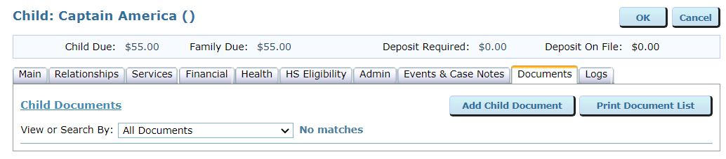
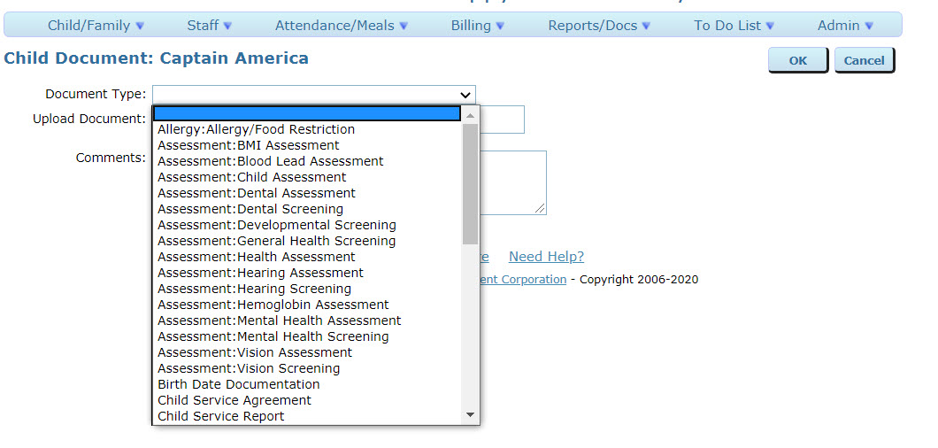
Child Documents

Slide 37
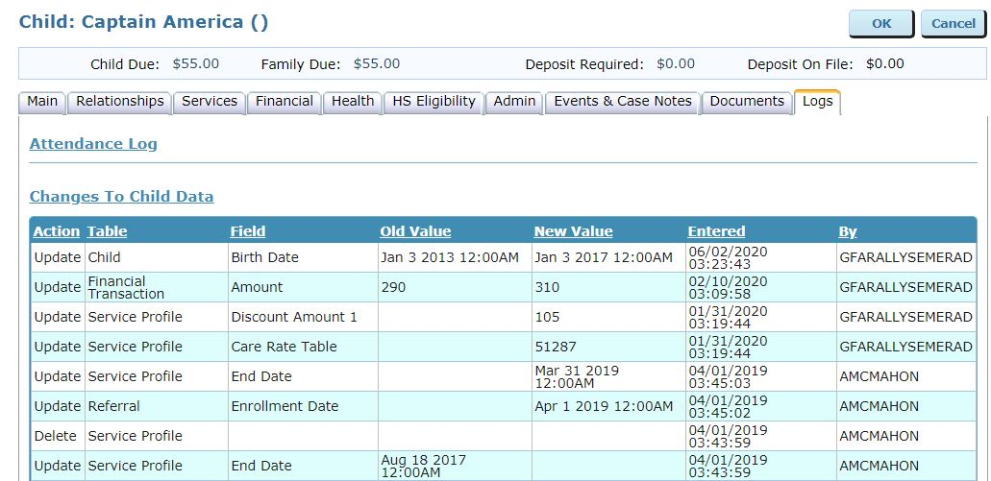
Child Logs

Slide 38
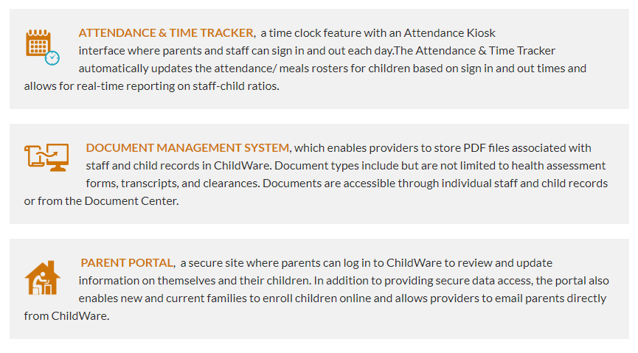
Attendance & Time Tracker and
Document Center

Slide 39
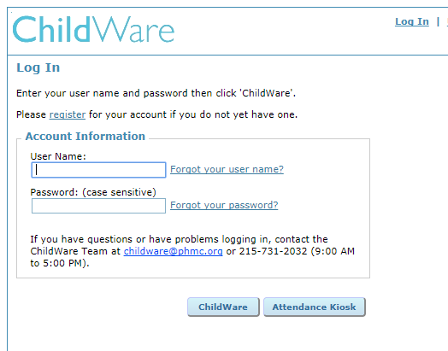
Attendance Kiosk

Slide 40
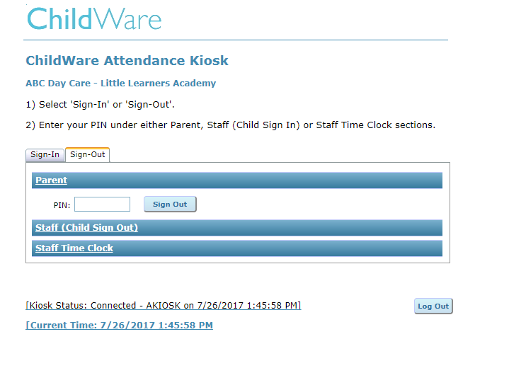

Slide 41
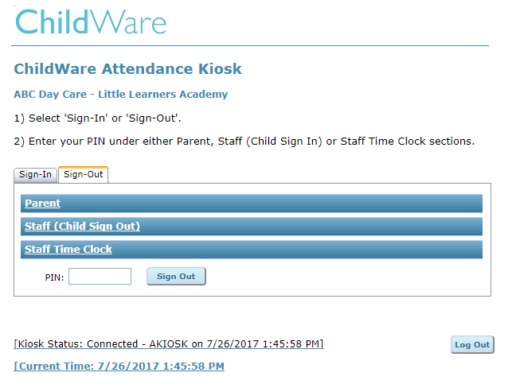
Staff Sign In & Out

Slide 42
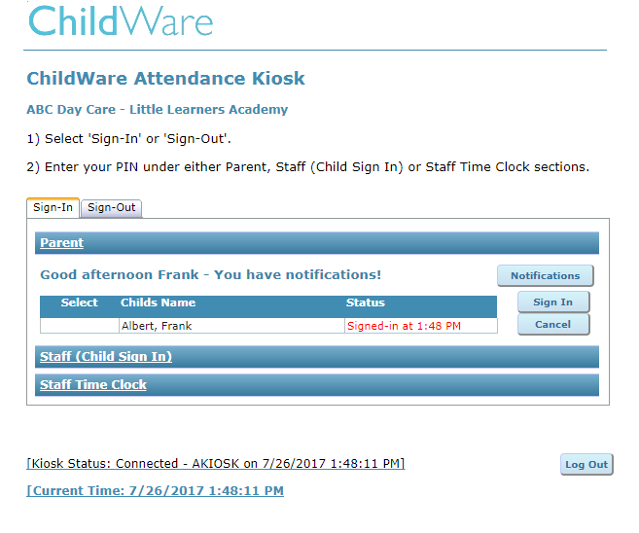

Slide 43
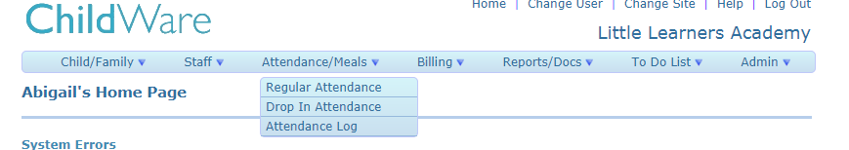
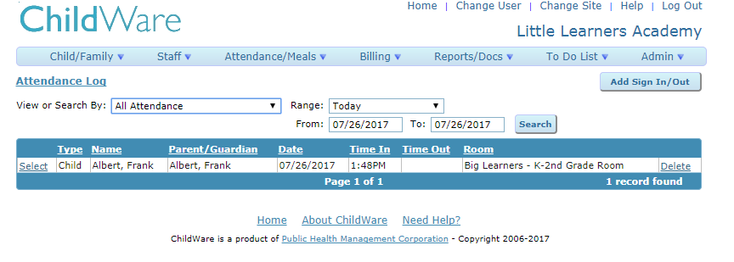
Kiosk Data and Attendance Log

Slide 44
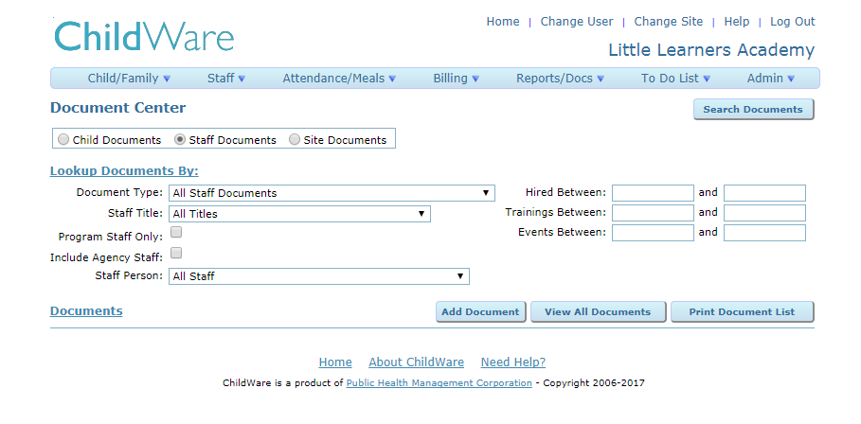
Document Center

Slide 45


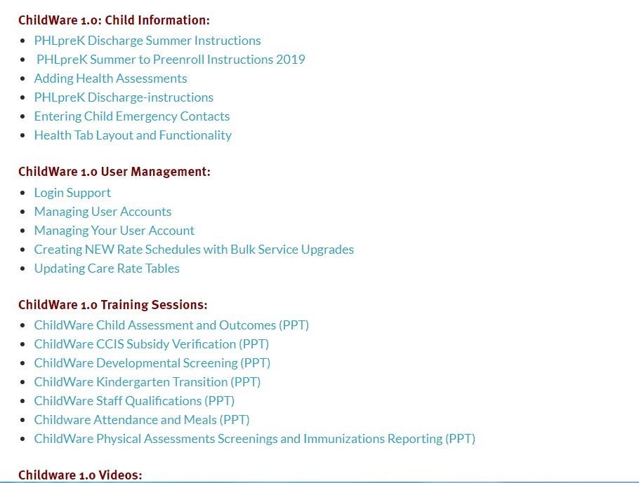
Support and Resources
24/7 support is available by emailing helpdesk@phmc.org
Online documentation and videos available at www.childware.org

Slide 46

This Photo by Unknown Author is licensed under CC BY-SA-NC

Slide 47


Slide 48
Let’s go LIVE! www.childware.org

